Slide 1
Topics
Overview of MapReduce
Advantages of MapReduce
YARN Overview
YARN Architecture
YARN Components
YARN – Job Execution Flow
Input/Output Formats
API Classes
MapReduce Program Execution

Slide 2
MapReduce
Hadoop MapReduce is a programming model for writing applications that can process Bigdata in parallel on multiple Nodes.
MapReduce algorithm contains two important phases, namely Map phase and Reduce phase

Slide 3
Advantages of MapReduce
Parallel Processing.
  So that we can process huge data very quickly.
Data Locality
  In MapReduce we move process to where data resides.

Slide 4
YARN
YARN is Hadoop's cluster Resource management system. Yarn is introduced in Hadoop 2.x.
With Yarn, we have the following advantages.
1. Scalability
  MapReduce-1 supports only 4000 nodes and 40,000 tasks size cluster, beyond that it hits scalability bottlenecks. Because in MapReduce-1 job tracker takes care of both job scheduling and task progress monitoring.
  In yarn these responsibilities are handled by separate entities, Resource manager and Application master. It is designed to scale upto 10,000 nodes and 100,000 tasks.
  2. Multi-tenancy
  In Hadoop-1.x we can execute only MapReduce type jobs, which are batch process. In Hadoop-2 with Yarn, we can execute other types of distributed applications like (streaming , online, graph, interactive,..)

Slide 5
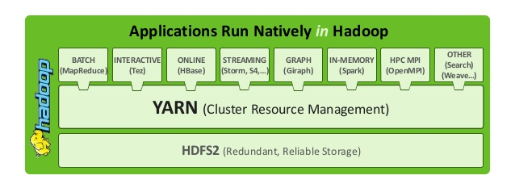
YARN - Multitenancy
The biggest benefit of YARN is that it opens up Hadoop to other types of distributed application. MapReduce is just one YARN application.

Slide 6
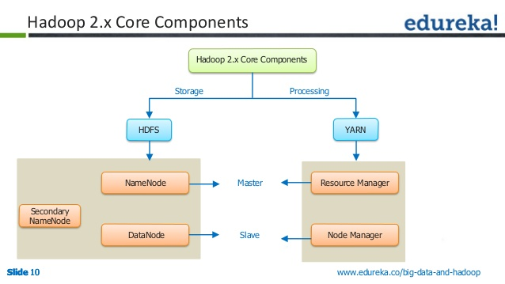
Hadoop 2.x Daemons

Slide 7



YARN Architecture
Next Generation MapReduce (MapReduce-2)
Client
Resource Manager
Scheduler
Application
Manager
Node -1
Node -2
Node Manager
Node Manager
Container
Appl
Master
Container
Appl
Master

Slide 8
YARN Components
Client
  Submit MR Job
Resource Manager
  Cluster Level Resource management
Node Manager
  One per Datanode
  Manages resources on Datanode
Application Master
  One per application
  Co-ordinates and manages MR Jobs
  Negotiate with Resource Manager
Container
  Created by Node Manager
  Allocates resources on slave node
Job History Server
  Maintains history of submitted jobs.

Slide 9
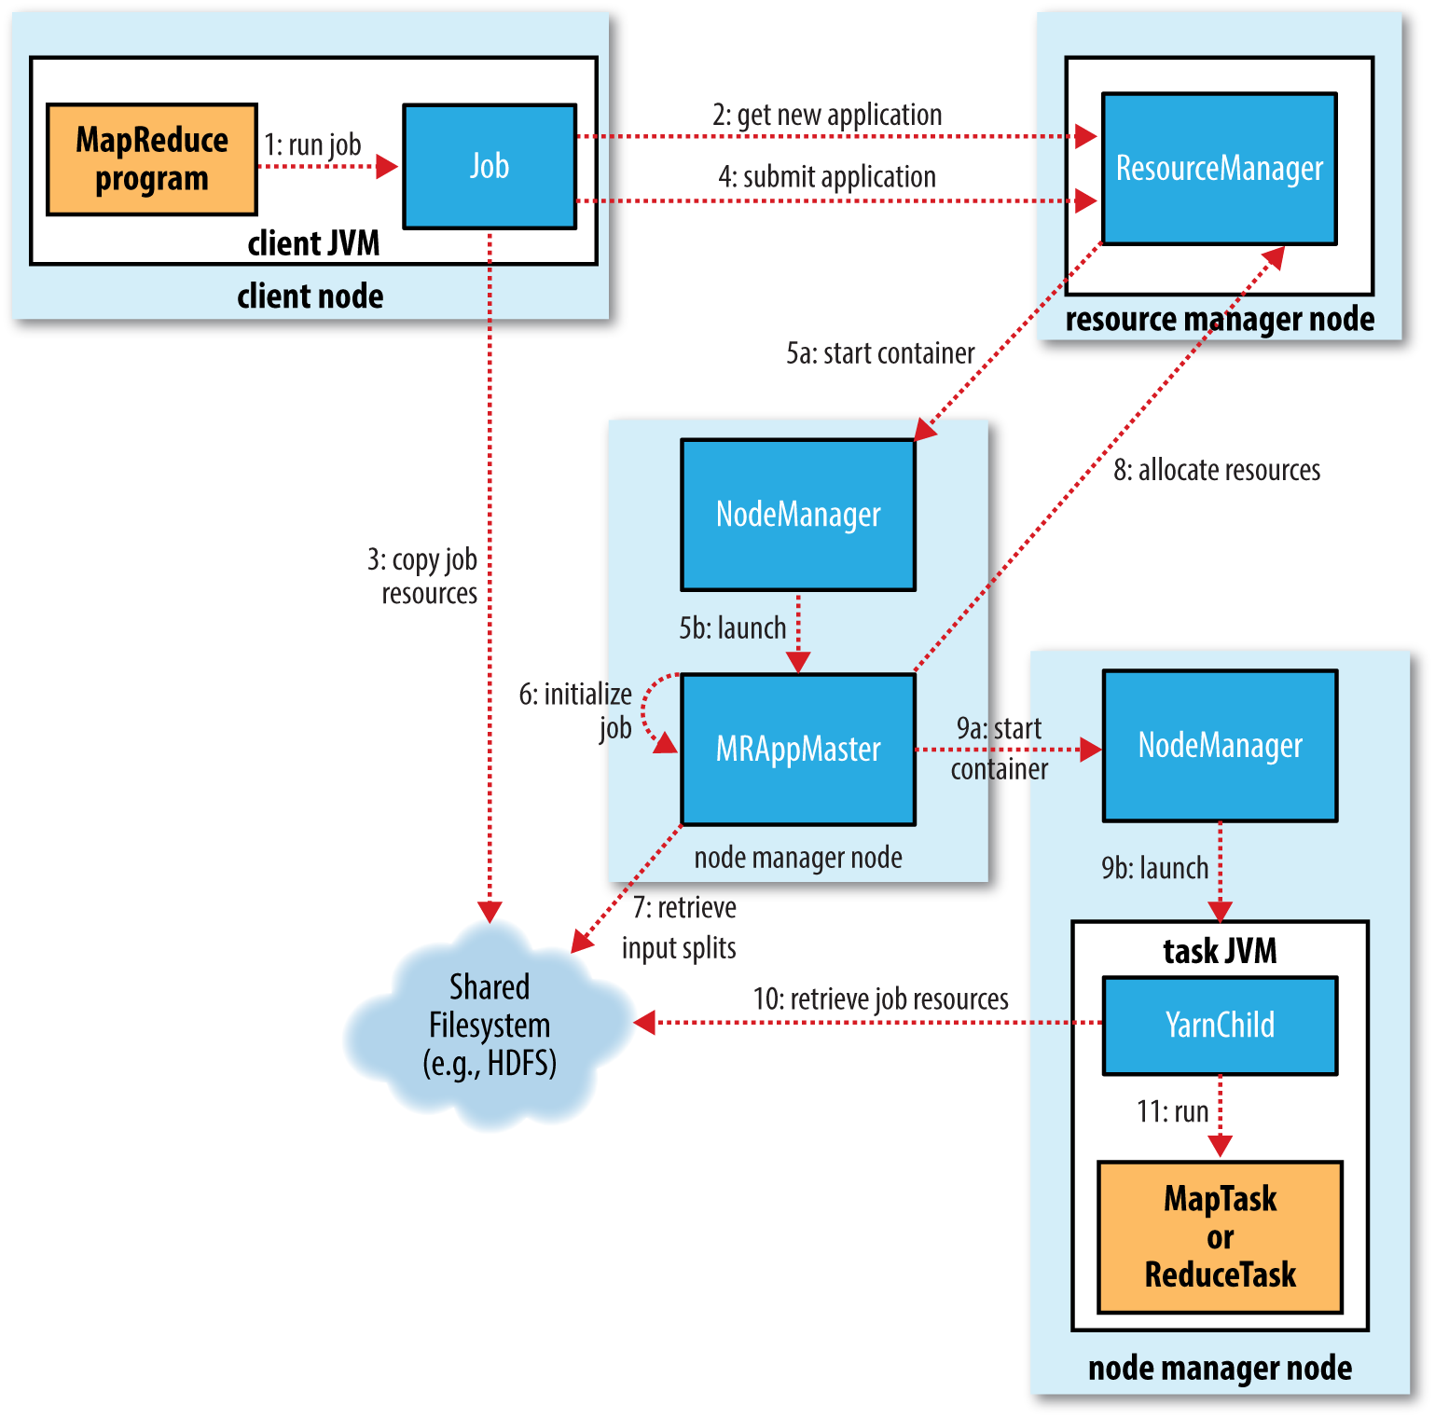
YARN - Job Execution Flow

Slide 10
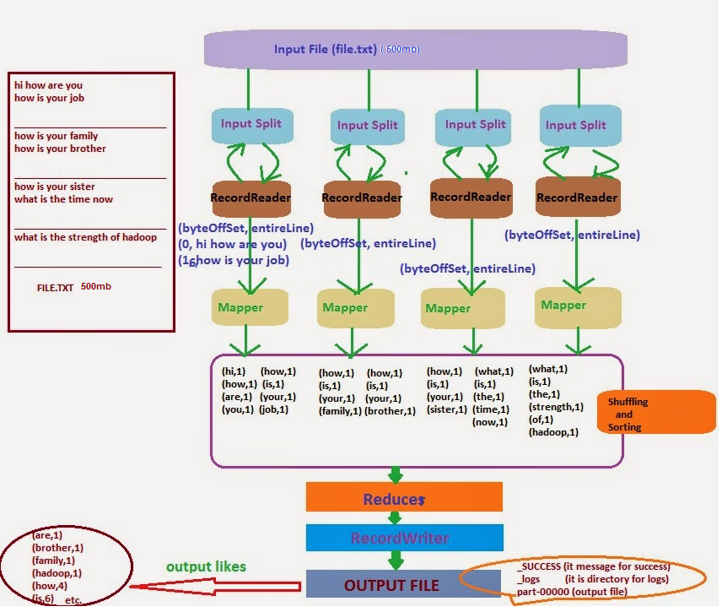
WordCount Program

Slide 11
InputFormat
TextInputFormat
  Is the default InputFormat. Each record is a line of input. The key, a LongWritable, is the byte offset within the file of the beginning of the line. The value is the contents of the line, excluding any line terminators
KeyValueTextFormat
  Each record in a file is a key-value pair, separated by a delimiter such as a TAB character. You can specify the separator via the
  mapreduce.input.keyvaluelinerecordreader.key.value.separator property.

Slide 12
InputFormat
NLineInputFormat
  If you want your mappers to receive a fixed number of lines of input, then NLineInputFormat is the InputFormat to use.
SequenceFileInputFormat
  Usually sequence file is created by a program / or receive as a program output. Keys and values are determined by the sequence file. We should make sure that Mapper input key and value matches this.

Slide 13
OutputFormat
TextOutputFormat
  This is the default OutputFormat. TextOutputFormat writes records as lines of text. Here key and value are converted to string. Key and value are separated by a TAB Character. You can change this using the mapreduce.output.textoutputformat.separator property.
SequenceFileOutputFormat
  SequenceFileOutputFormat writes sequence files for its output. This is a good choice of output if it forms the input to a further MapReduce job.

Slide 14
API Classes
org.apache.hadoop.mapreduce.Mapper
Maps input key/value pairs to a set of intermediate key/value pairs.
public class MyMapper extends Mapper<KEYIN,VALUEIN, KEYOUT,VALOUT >{
public void map(Object key, Text value, Context context)
throws IOException, InterruptedException {
//mapper code goes here..
}
}
Context :
  It is a inner class in Mapper used to emit key-value pairs.
public void write(KEYOUT key, VALUEOUT value) throws Exception

Slide 15
API Classes
org.apache.hadoop.mapreduce.Reducer
Reduces a set of intermediate values which share a key to a smaller set of values.
Reducer has 3 Phases
  Shuffle
  Sort
  Reduce
public class MyReducer extends Reducer<KEYIN,VALUEIN, KEYOUT,VALOUT >{
public void map(Object key, Text value, Context context)
throws IOException, InterruptedException {
//Reducer code goes here..
}
}

Slide 16
API Classes
org.apache.hadoop.conf.Configuration
  Provides access to configuration parameters. Configurations are specified by resources. Hadoop by-default uses two resources
    core-default.xml
    core-site.xml
org.apache.hadoop.mapreduce.Job
  It allows the user to configure the job, submit it, control its execution, and query the state.
org.apache.hadoop.fs.Path
  Names a file or directory in a FileSystem.

